Slide 1
Delivery Time Prediction
Provided order memo exports in form of text files, task is to develop predictive model that can effectively predict food order delivery time.

Slide 2
Introduction
We are aligned as Data Scientist for a fictitious food order delivery company.
The management of the company has decided to move forward with AI driven approach of computing the expected food order delivery time instead of using rule based approach.
Historical data comprising of food order memos are exported as text files which contains attributes that needs to be used to develop a predictive model that can effectively predict delivery time of the order.
The exports are unstructured and require harmonization/consolidation as part of ETL cycle before data preprocessing can be applied on the data.

Slide 3
Data Schema
Attribute Name | Data Type
ID | String
Delivery_person_ID | String
Delivery_person_Age | Integer
Delivery_person_Ratings | Float
Restaurant_latitude | Float
Restaurant_longitude | Float
Delivery_location_latitude | Float
Delivery_location_longitude | Float
Order_Date | Date
Time_Orderd | Time
Time_Order_picked | TIme
Weather conditions | String
Road_traffic_density | String
Vehicle_condition | Integer
Type_of_order | String
Type_of_vehicle | String
multiple_deliveries | Integer
Festival | String
City | String
Time_taken (min) | Float

Slide 4
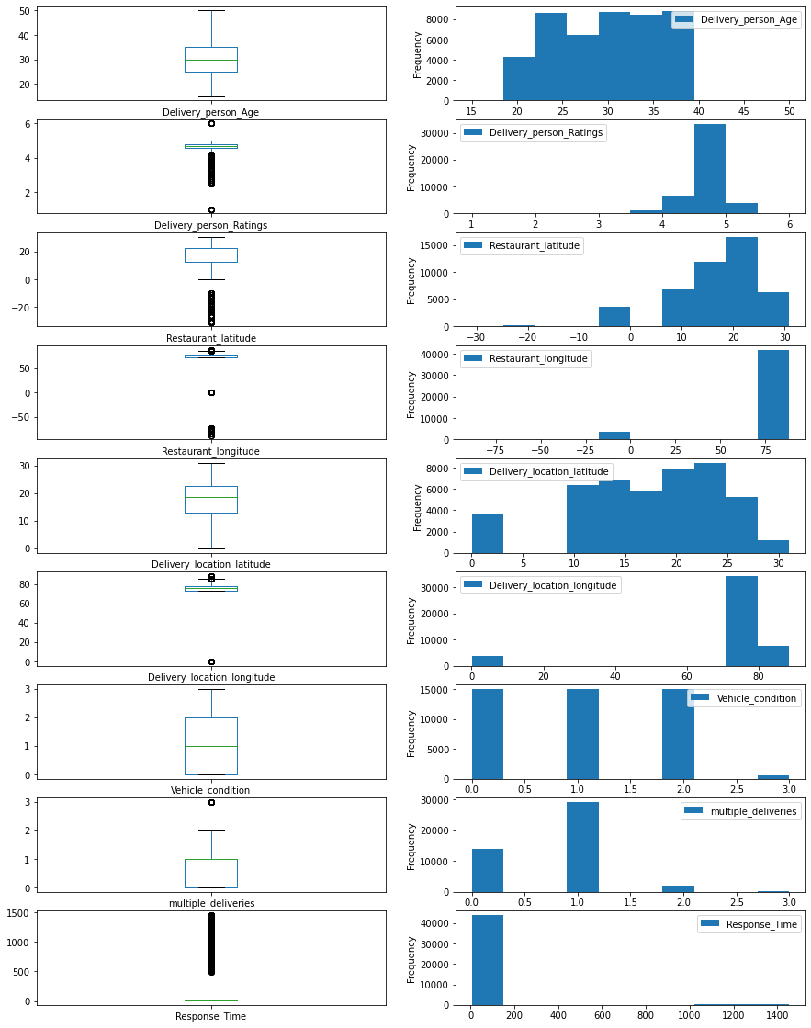
Distribution of numeric features
Average delivery executive age is 30 years.
Mode of delivery ratings is in range 4.5 - 5
Vehicles falling in high quality bucket is significantly less as compared to medium and low quality buckets
Response Time = Ordered Time – Order Pick Time
Response time is feature engineered attribute . The outliers exists for value >= 500

Slide 5
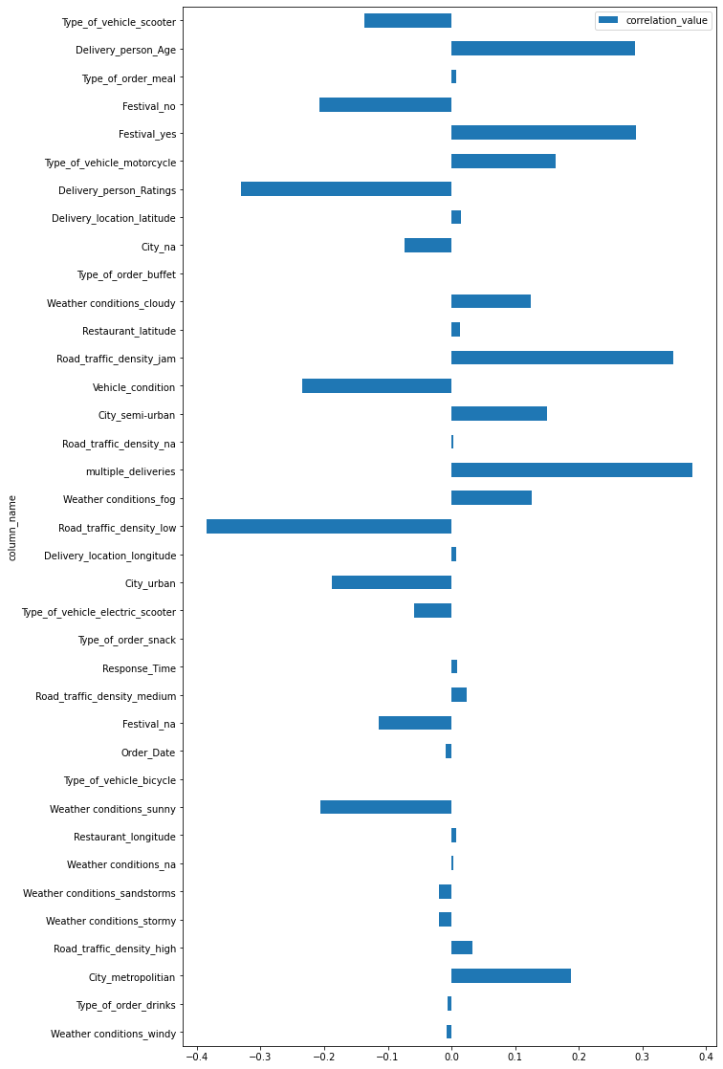
Correlation Analysis (With respect to target attribute)
Insight
For a positive correlation between two attributes, say ‘A’ and ‘B’ means that with increase in one quantity other increases (Linearly) and negative correlation corresponds with one’s increase causes decrease of other (Linearly).
multiple_deliveries show highest positive correlation with respect to target.
Road_traffic_density_low boolean flag shows greatest negative correltion

Slide 6
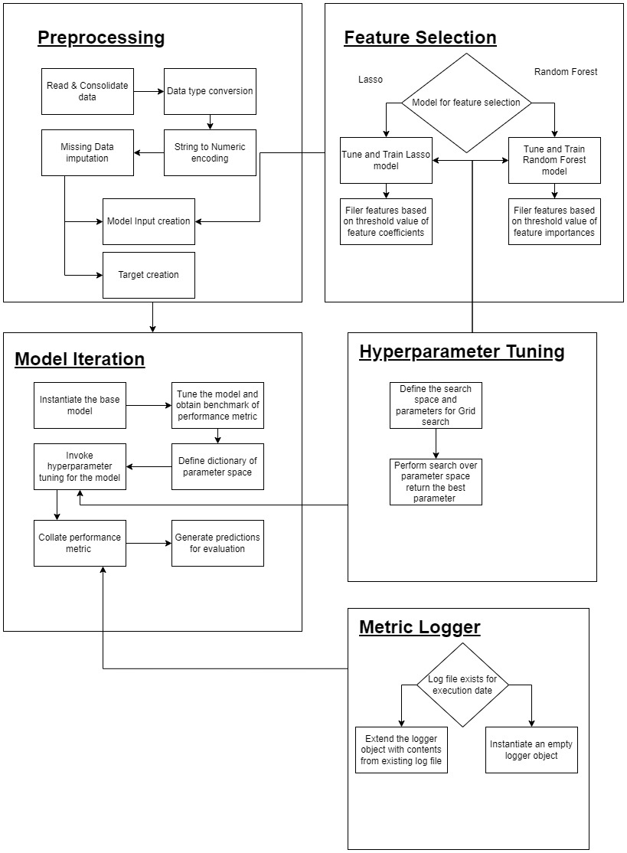
Approach

Slide 7
Experiment View
I have experimented with below models (with and without hyperparameter tuning):
XGB Regressor
LGBM Regressor
Support Vector Machine Regressor
CatBoost Regressor
The Models has been tested against below data preprocessing variations:
Feature selection using Lasso
Feature selection using Lasso and Normalization of features
Principle component dimensionality reduction and Normalization
Principle component dimensionality reduction, feature selection using Lasso and Normalization

Slide 8
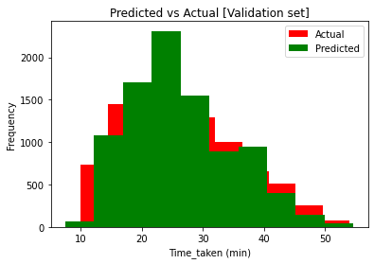
Results
The best R2 score has been obtained with CatBoost model on Lasso feature selection applied, normalization of fetature and hyperparameter tuning applied.
Best overlap between actual and predicted values

Slide 9
References
LGBM Regressor -> https://lightgbm.readthedocs.io/en/v3.3.2/pythonapi/lightgbm.LGBMRegressor.html#lightgbm.LGBMRegressor
CatBoost Regressor -> https://catboost.ai/en/docs/concepts/python-reference_catboostregressor
Support Vector Machine Regressor -> https://scikit-learn.org/stable/modules/generated/sklearn.svm.SVR.html
Lasso Regressor -> https://scikit-learn.org/stable/modules/generated/sklearn.linear_model.Lasso.html
Random Forest Regressor -> https://scikit-learn.org/stable/modules/generated/sklearn.ensemble.RandomForestRegressor.html
XGBoost Regressor -> https://xgboost.readthedocs.io/en/stable/python/python_api.html#xgboost.XGBRegressor
Grid search -> https://scikit-learn.org/stable/modules/generated/sklearn.model_selection.GridSearchCV.html

